Slide 1
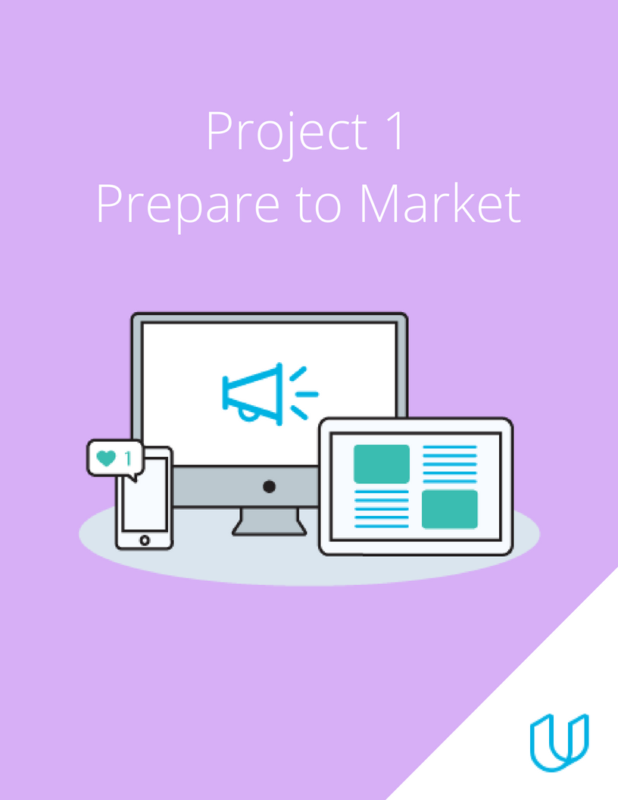
BY: PEACE NGOZI AGHEDO

Slide 2
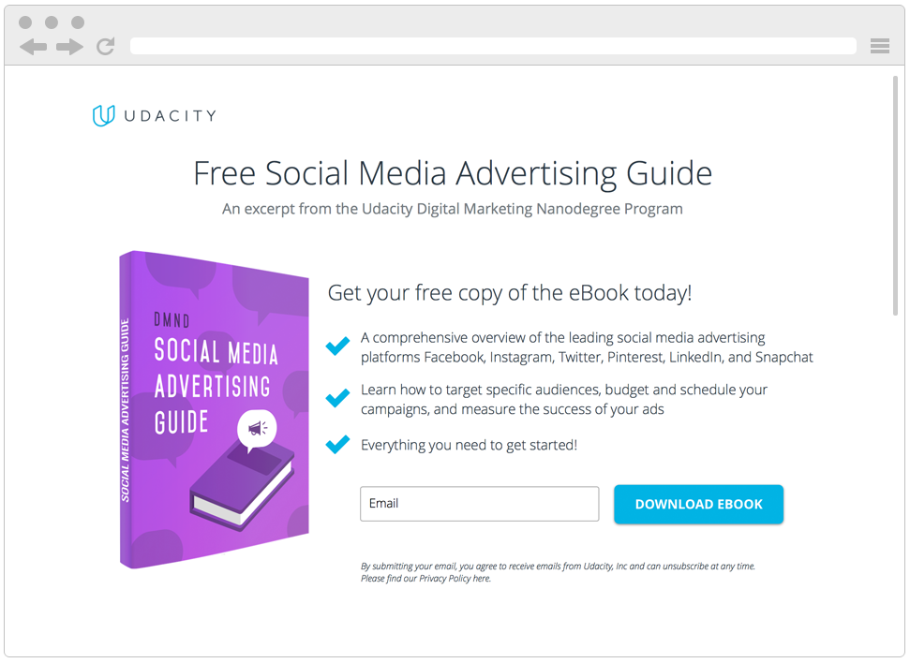
Digital Marketing Nanodegree Program
You are tasked with attracting future fellow students for this Digital Marketing Nanodegree Program. More specifically, your objective is to collect email addresses of potential students, who could be interested in taking this course. In order to do this, we have created a landing page where prospective students can download a free eBook if they provide us with their email address. The eBook – a Social Media Advertising Guide – is a short excerpt from the Digital Marketing Nanodegree Program, content that you will see in the Social Advertising course. For the purpose of the projects, assume costs of $0 for the eBook and a conversion value (revenue) of $15 per collected email address.

Slide 3
DMND Program
Which option did you choose?
Udacity
If Udacity, which product did you choose? DMND Program

Slide 4
DMND PROGRAM
MARKET OBJECTIVE: To have 300 Digital Marketing Nanodegtree Program prospective students download the free eBook with a 30% conversion rate of individuals who originally visited the page in February 2022.
PRIMARY KPI: The KPI for the Udacity marketing objective would be the number of persons who downloads the eBook by providing us with their email.

Slide 5
DMND PROGRAM
VALUE PROPOSITION
FOR: Individuals interested in pursuing a course in Digialketing.
WHO need a curriculum to guide them in the pathhway of the Digital Marketing course.
OUR Digital Marketing Curriculum/Guide
THAT offer efficient Digital Marketing Lessons
UNLIKE Digital Marketing Courses at Coursera
OUR OFFER equips you with vital knowledge necessary to become highly proficient in Digital Marketing and a person of value and interest in the Digital Marketing World.

Slide 6
DMND PROGRAM
INTERVIEW QUESTIONS
Kindly find below a google link for the interview questions.
Interview Questions

Slide 7
DMND PROGRAM
EMPATHY MAP
THINKING
- Believes the world has gone tech all round,
- Wants to pursue a course in Digital Marketing.
- Dissatisfied with his current job.
- Believes he will find fulfillment in Digital Marketing.
DOING
- Newly wedded with a baby boy.
- Works as a cashier to a microfinance bank.
- Searching for an online Digital Marketing Program.
- Compares cost to run a Digital Marketing course with Udacity.
SEEING
- Exercise fanatic
- Already sees himself as a digital marketer.
- Sees Movies at leisure
FEELING
- Exhausted
- Frustrated
- Has doubts about the future
- Ready to pursue the Digital Marketing Program
- With digital Marketing Skills I can now make more money to take care of my family.

Slide 8
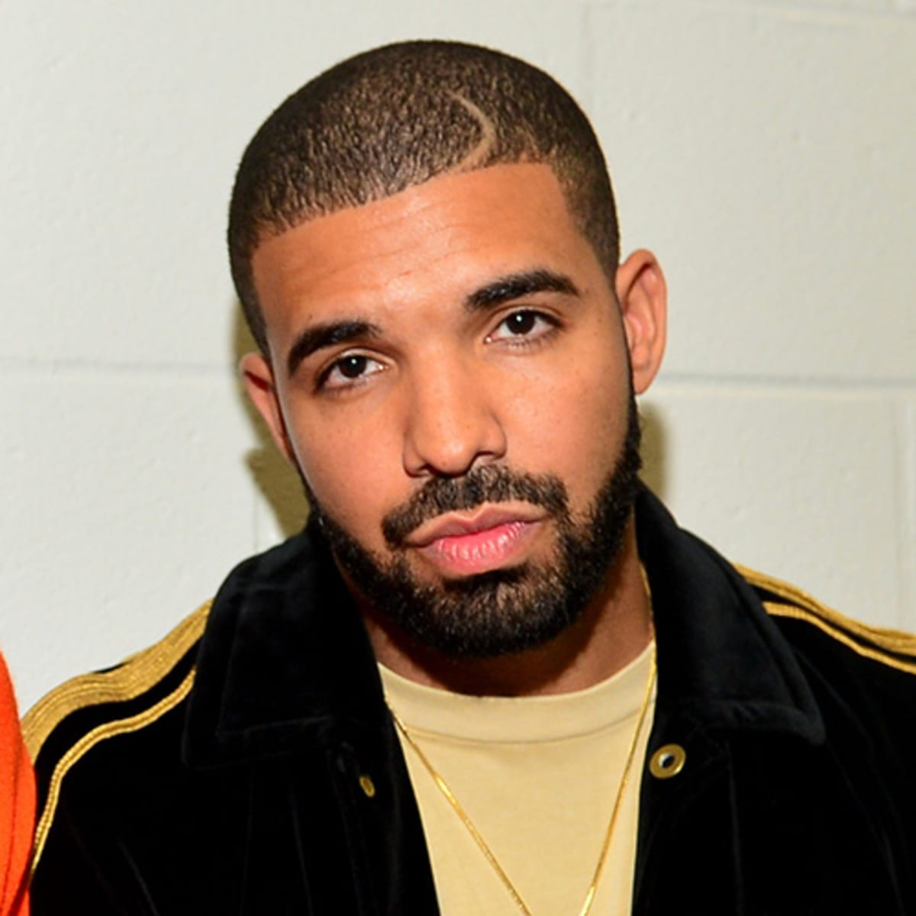
Target Persona
Background and Demographics | Target Persona Name | Needs
AGE: 40 GENDER: Male MARITAL STATUS: Married NUMBER OF CHILDREN: 3 COUNTRY: Nigeria STATE OF RESIDENCE: Edo EMPLOYED: Yes ANNUAL INCOME: 1 million naira HIGHEST CERTIFICATION: Masters Degree | MATTHEW | Sufficient internet network. Projects to practice Digital Marketing. Better work and better cash inflow. Tutorial videos
Hobbies | Goals | Barriers
Play FIFA PES Travel Singing Dancing Chess | A better job Does not see self in this same industry in the next 3 years. Sees self as a high profiled Digital Marketer in the next 3 years. | High cost of data poor Internet Financial constraints Too many responsibilities at work.

Slide 9
THANK YOU

